Slide 1

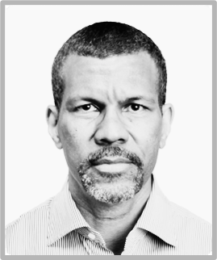
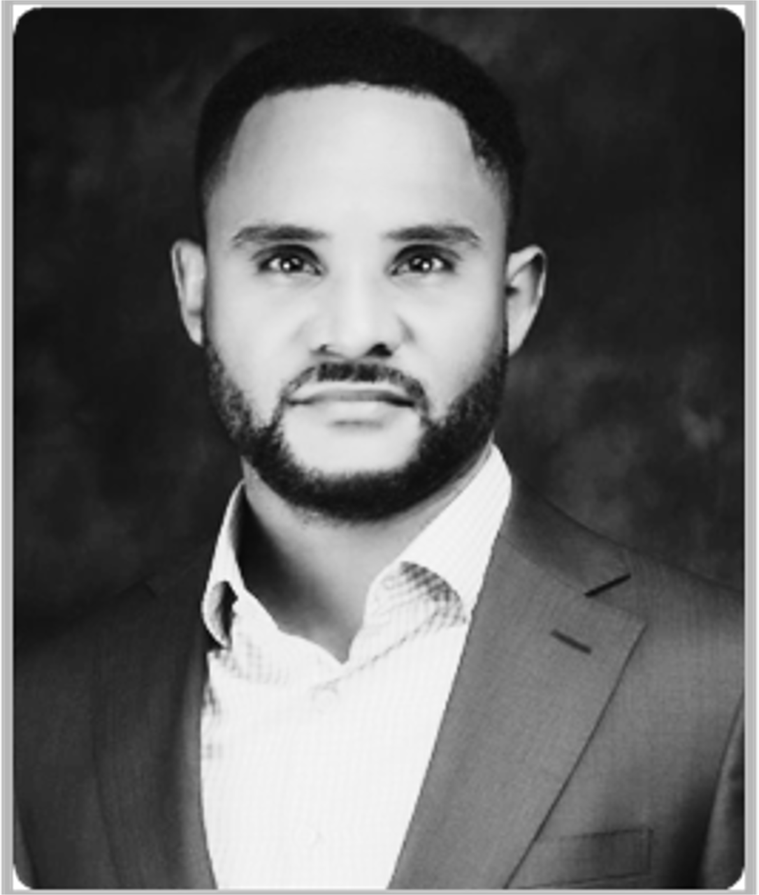
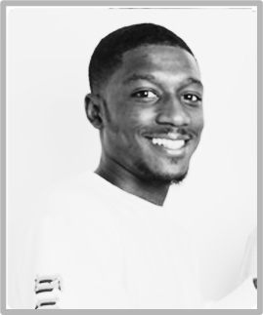
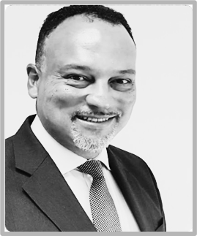
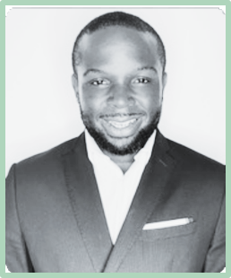
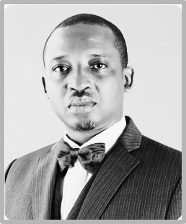
Healthcare
OUR TEAM
Corporate experience in Nigerian Tech, Banking, Telco, Healthcare
CAPT. DAPO OLUMIDE
IVE CHIKE MEME
ISA IBRAHIM
DR AYOTUNDE COKER
RICHARD FISHER
Aliyu Aliyu
SHAIBU BAIYEE
Chairman
Founder & Chief Executive Officer
Co Founder & Tech Executive director
Non Executive director
Non director
Non Executive director
Non Executive director
Captain Olumide is the Interim CEO of Nigeria Air, and the former presidential pilot for the Federal Republic of Nigeria. Former CEO of airlines Virgin Nigeria, Aero contractors, and former Director at the Africa Finance Corporation (AFC).
In the last 20 years he has worked across the EMEA sales region representing both Fortune 500 FTSE 100 companies and software start-up companies. Experienced in international corporate governance and sales process with a passion to solve life problems with Tech.
Isa is a proven programmer, engineer, and entrepreneur with a BSc in Material Science and Engineering from Imperial College London. He has another start-up, AppTap, in Open Banking located in London UK. Working with some Europe’s largest banks and utility service providers.
Dr Ayotunde Coker (Tunde) is the CEO of Open Access data centres Pan Africa. Tunde has over 30 years' international experience. Former Access Bank CIO, a Tier 1 bank in Nigeria pan African bank. Tunde also was the former IT director of various International Oil Companies and the UK government Ministry of Justice
Richard Fisher began working at Bloomberg in 2005 and relocated from London to Dubai to manage Bloomberg's electronic trading business across the Middle East and Africa. Richard has another start-up in Education located in Dubai.
Former Special Assitena Mr Baiyee (Shai) holds an MBA degree in Oil & Gas Management from the Centre for Energy, Petroleum, Mineral Law
& Policy, University of Dundee, Scotland and a ﬁrst degree in Politics &Economics from the University of Buckingham England. Currently works in Federal government.

