Slide 1

HITACHI DIGITAL SECURITY
This is the digital business era and it’s creating both opportunities and security threats.
Presenter: Ive Chike Meme
www.environ-ng.com

Slide 2


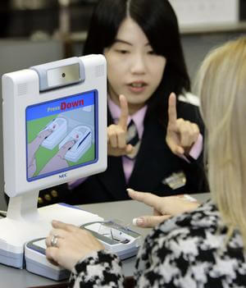
'Fake fingerprint' Chinese woman fools Japan controls
18:27 GMT, Monday, 7 December 2009
A Chinese woman managed to enter Japan illegally by having plastic surgery to alter her fingerprints, thus fooling immigration controls, police claim.
Skin patches on her thumbs and index fingers were removed and then re-grafted on to the matching digits of the opposite hand.
Japanese newspapers said police had noticed that Ms Lin's fingers had unnatural scars when she was arrested last month for allegedly faking a marriage to a Japanese man.
Source: http://news.bbc.co.uk/2/hi/8400222.stm

Slide 3





Near infrared light is absorbed by haemoglobin in the blood and the vein pattern is captured as a shadow
Vein image is quite stable due to the inner structure of body
Resistance against environmental condition or body surface
THE ENVIRON-HITACHI
SOLUTION
NEAR-INFRARED LIGHT
VEIN
ABSORBED
NON-SPOOFING BIOMETRIC – Use without consent
PROOF OF LIFE
PASS THROUGH
CAMERA
NEAR INFRARED LIGHT
Penetration of human body begins at this wavelength
UV rays
Visible light
Infrared rays
0.4 µm 0.7 µm 1 µm
Short
Wavelength
Long

Slide 4


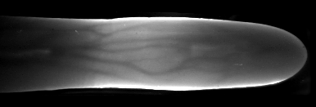
FINGERVEIN FUNDAMENTALS
NEAR INFRARED LIGHT
Feature
Extraction
10110110
00111100
10011011
Image Processing
Biometric Template
BLOOD VESSEL
Imaging
IR CAMERA
Finger vein imaging by light transmission

Slide 5




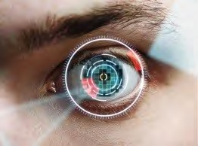

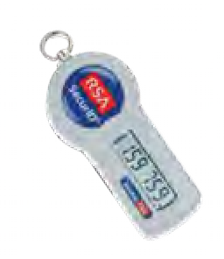
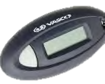


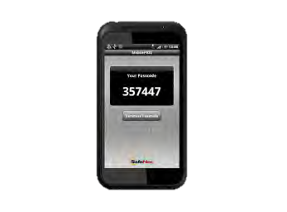
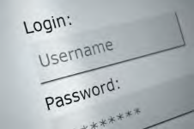



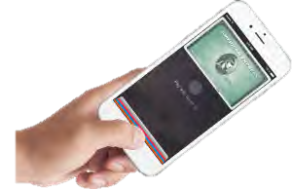
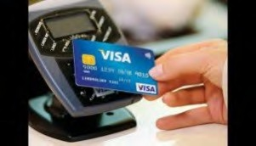

SECURITY PAYMENTS LANDSCAPE
Certainty of
Individual Authorisation
VeinID+PKI
SECURITY LEVEL
VeinID / IRIS
Certainty of
Individual Identification
Secure Access Token (SecurID)
One Time Password (OTP)
Username / Password
Fingerprint (e.g. Apple Pay)
NFC
PAYMENT VALUE

Slide 6

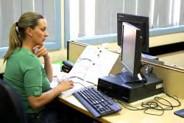
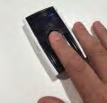
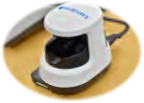
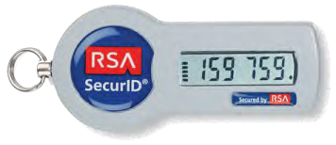
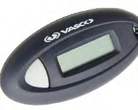
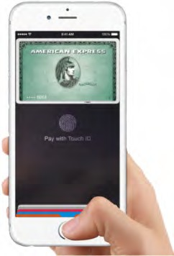
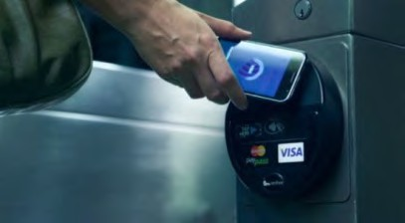
B1/B2 WHERE DOES IT FIT
Large value corporate payments authorization
Medium opportunity for fraud.
Corporate payments verification & repair High opportunity for fraud.
Corporate payments input High opportunity for fraud.
Corporate
Small business and commercial user
Retail mobile user.
Medium security
Medium opportunity for fraud.
Retail eWallet & Finger Print.
Low security
Medium opportunity for fraud.
Retail NFC.
Low security
High opportunity for fraud.
Retail / SME

Slide 7






HITACHI B1/B2 WHERE DOES IT FIT
Difficulty of Forgery
Vein
Difficulty of Replication
Difficulty of Acquisition
Iris
SPECIAL TECHNOLOGY REQUIRED
Hand
Voice
VERY DIFFICULT
KNOWN
TECHNOLOGY
Face
Fingerprint
MODERATE
EASY
EASY
Finger Vein is an internal biometric
It is very difficult to obtain finger vein patterns
It is very difficult to replicate finger vein patterns

Slide 8
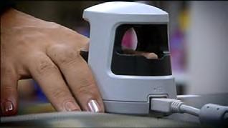
HITACHI B1/B2 WHERE DOES IT FIT
“Brochure Figures” for the H1 Scanner
Failure To Enrol FTE < 0%
False Rejection Rate FRR = 0.01% (one in ten-thousand)
False Acceptance Rate= 0.0001% (one in a million)
For comparison Apple Touch ID FAR is 1:50,000 for one finger enrolled and is 1 in 10,000 with 5 fingers enrolled.
Apple do not publish FRR rates however worth looking at https://www.wired.com/2013/12/touch-id-issues-and-fixes/
Matching Times on 1:1 local match | Hitachi Finger Vein | Fujitsu Palm Vein | IrisGuard Iris
Median recognition attempt duration (s) | 1.23 | 2.13 | 4.22
Median enrolment duration (s) | 33.3 | 61.7 | 44.5

Slide 9
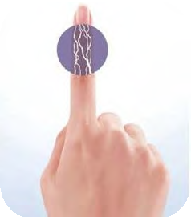
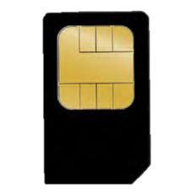
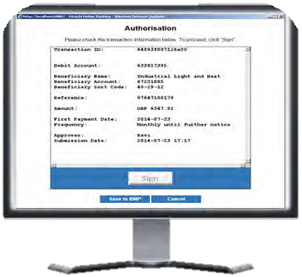
Powerful finger vein biometric
PKI
cryptographic infrastructure
Browser­ based “sign what you see”
A COMBINATION OF THREE TECHNOLOGIES

Slide 10
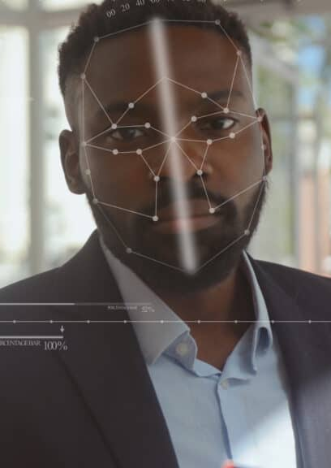
Police use of facial recognition continues to raise public concerns
Police forces think it’s good, privacy advocates think it’s bad, others say let tests decide
May 21, 2025, 4:16 pm EDT | Joel R. McConvey
CATEGORIES Biometrics News | Facial Recognition | Law Enforcement
Should police use facial recognition technology? Two-thirds of Milwaukee’s Common Council says no. An article in the Milwaukee Journal-Sentinel says 11 of 15 alderpersons signed a letter opposing use of the facial recognition technology by the Milwaukee Police Department, citing concerns about bias and potential overreach.
Studies showing that the majority of facial recognition algorithms are more likely to misidentify people with darker skin, women and the elderly (though the most accurate algorithms show very low differentials in testing by the National Institute of Standards and Technology).

Slide 11
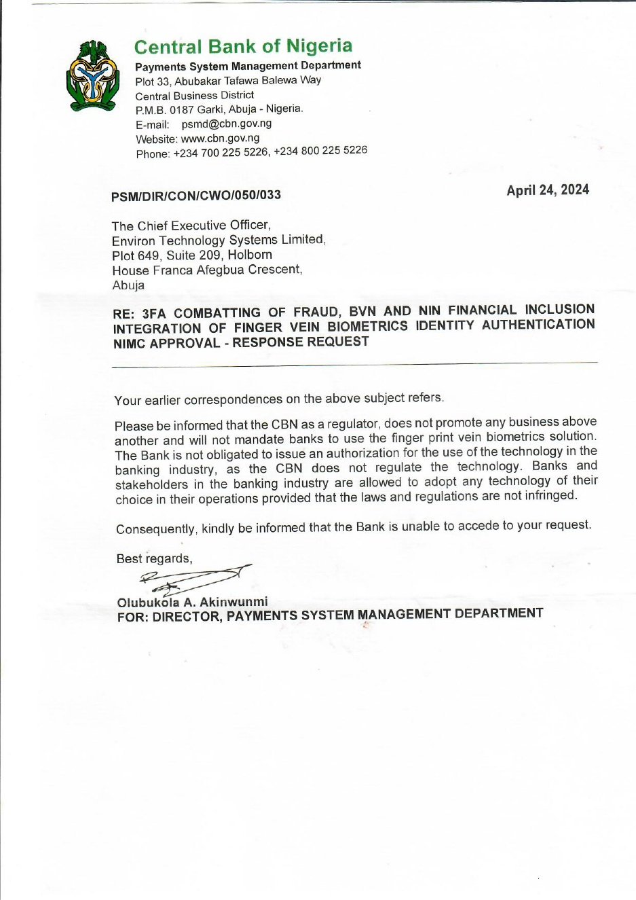
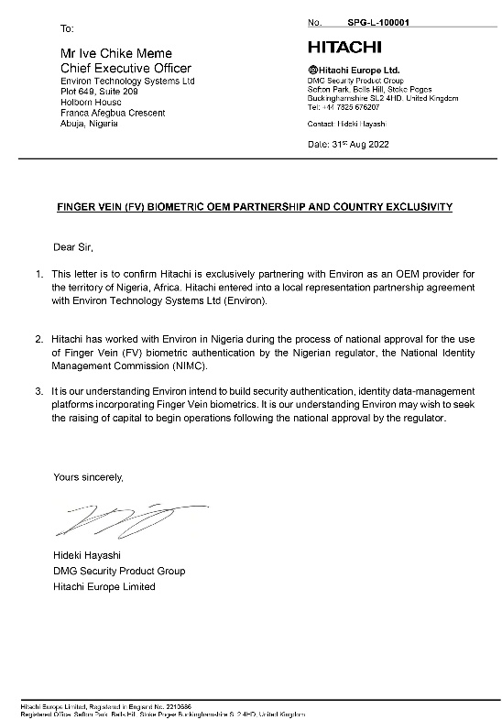
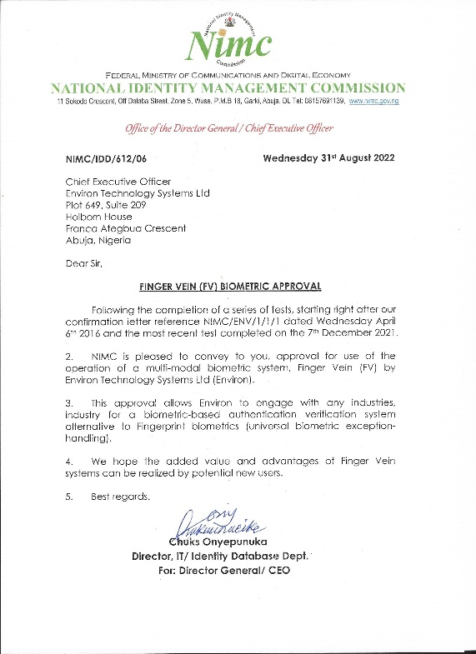
Regulator Manufacturer position
CBN LETTER 2024
HITACHI LETTER 2022 & NIMC LETTER 2022

Slide 12
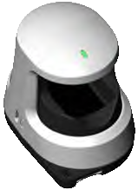
Device | H1 and N4E
Use case | Mobile, Desktop
Connectivity | Wi-Fi, USB
Image processing | On­board
PKI and Finger Vein | On­SIM
Size H x W x D | 74 x 59 x 82mm
Weight | 102g
Features | LED, buzzer, SIM slot.

Slide 13

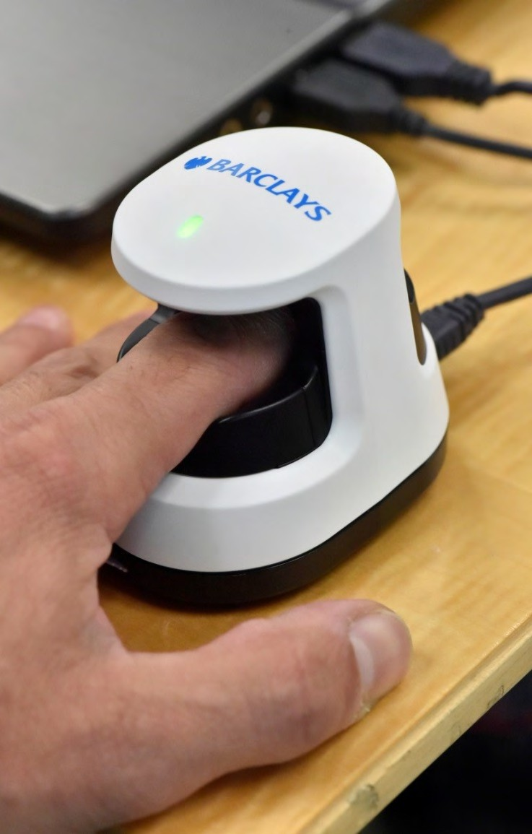

CASE STUDIES
Why did Barclays adopt this solution?
Hitachi’s Identity Assurance Solution set to revolutionise account security in UK banking
“This solution is at the leading edge of innovation
and is in direct response to client concerns about the threat of online fraud.”
“We have shown the technology to a range of businesses and the interest and enthusiasm for the product is tremendous.”
“Ultimately, I hope this will pave the way for other institutions to adopt equally robust technology in the fight against online crime.”
Ashok Vaswani
CEO Barclays Personal and Corporate Banking
https://www.youtube.com/watch?v=ZNLAUJX8W8E

Slide 14
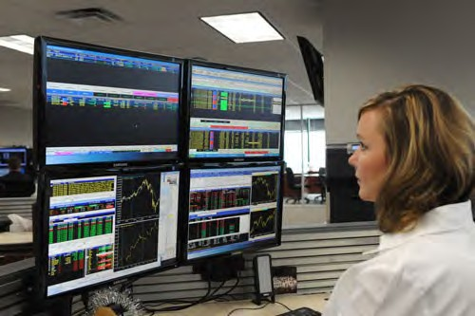

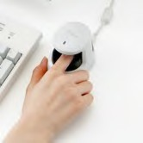
CASE STUDIES - TRADER AUTHENTICATION
1000 seats.
Strong authentication reduces “operational risks”. Instantly access and lock all a trader’s PCs.
No passwords or tokens, user is clearly linked to activity by their biometric.
Delegation of control.
Finger Vein selected as the optimal biometric.
“Trading room security is strategic for Natixis... We have strongly reduced access risks while improving trader productivity.”
Alain Bernard - Chief Security Officer

Slide 15


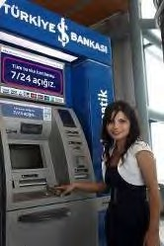
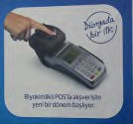
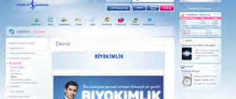
CASE STUDIES - BRANCH & ATM
Application:
ATMs
Payments (pilot)
Scale:
Approx. 3000 ATMs
More than 1000 branches
FV POS (pilot)
Business case:
Reduction of frauds in ATMs
The low popularity of ATMs (Bankamatik network)
Target: increase safety and popularity of ATM transactions
Development:
Expansion of payment network, branches

Slide 16

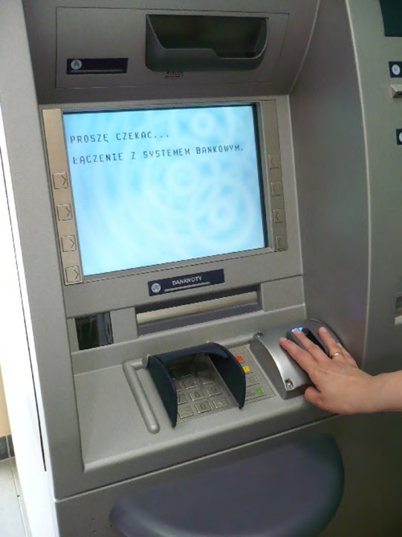
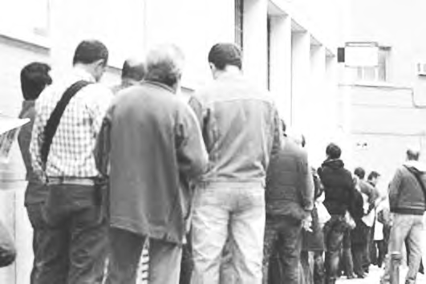
CASE STUDIES - ATM BENEFITS PAYMENTS
Reduction of time needed to service benefit claimants.
Security increase and Anti Fraud.
Increase service quality and convenience.
Reduced insurance cost of holding benefits cash in branch.
Elimination of Human error risk.
Access to service for people otherwise “digitally excluded”
Innovation and Leadership by the bank

Slide 17
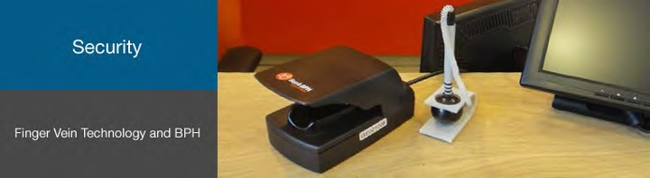
CASE STUDIES - IN BRANCH
Bank BPH is part of GE Capital Group, one of the largest corporations in the world.
Since January 2013 all Bank BPH branch offices in Poland have been using Finger Vein biometrics as a main method of authentication. Bank BPH SA is the first bank in Europe to introduce customer authentication based on Hitachi Finger Vein biometrics into their branch network.
Since January 2013 all Bank BPH branch offices in Poland have been using Finger Vein biometrics as a main method of authentication.
In total approx.1800 Finger Vein devices are implemented in the Bank BPH branch network.
Thanks to this, thousands of clients have the opportunity to carry out banking transactions without showing any identity documents and without additional passwords or PIN numbers. The only thing they need to do is to declare their identity (by name and surname or PESEL number) and put their finger on the Finger Vein device in the Bank BPH branch. At the same time clients still keep the right to use traditional authentication.
YouTube and Hitachi

Slide 18
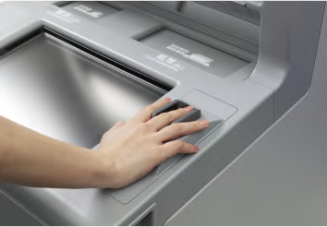











CASE STUDIES - ATM
80,000 FV ATMs in Japan
4000+ to date in Turkey
700 to date in Poland
Adopted by over 80% of Japanese banks

Slide 19
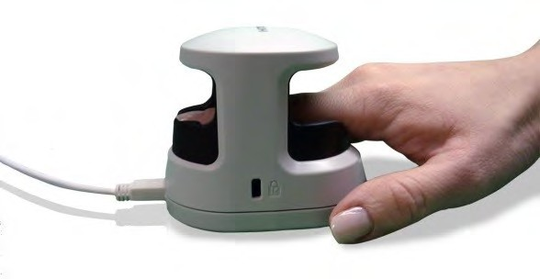

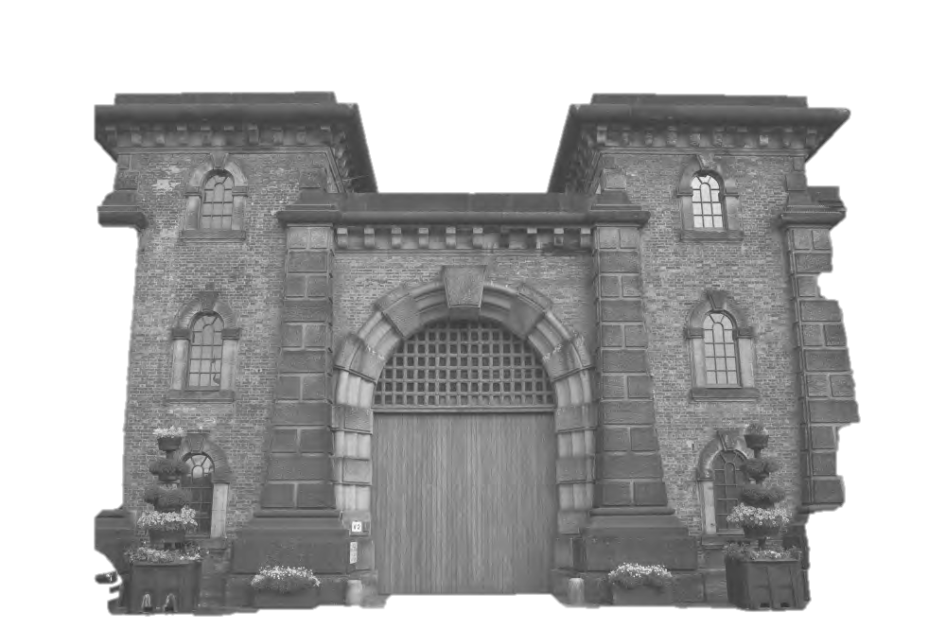
CASE STUDIES - PHYSICAL
ACCESS CONTROL
At an installation of Hitachi Vein technology with a trusted partner in 18 prisons across the UK, the biometric identity management system is used in conjunction with an ID card generation system. The vein technology allows staff to effortlessly enrol and discharge inmates, as well as giving them the ability to keep total control over any visitors entering and leaving the site.
“The implementation for HMPS has streamlined our registration process, this saves us a minimum of 81 working days a year, freeing officers for other duties and saving a lot of money”
Andy Livall – Prison Reception Officer

Slide 20
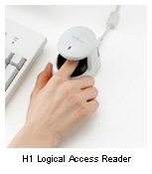





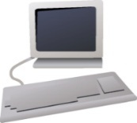

INTERNAL FRAUD COMBAT 3FA BRANCH OPERATIONS
USER PERMISSION RIGHTS IN REAL - TIME
DIGITAL SIGNATURE
2FA to 3FA Transition
LIVE ALERTS SMS, EMAIL On Attempts
Video Recorder
Server
User Terminals
Control Terminal
Programme propagates from server side to client side
VigilancePro
Server
Control Terminal
User Terminals
Access Control
Server
Client Side
Server Side

Slide 21
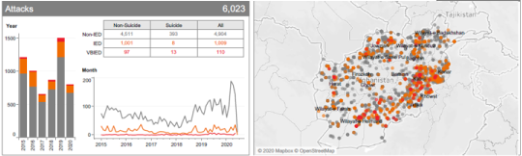
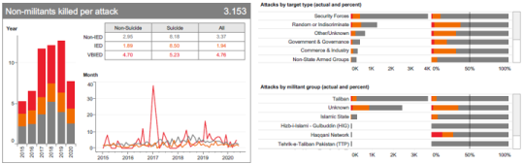
FOR THE NIGERIAN
DEPOSIT MONEY
INSTITUTIONS
AI-based trends analysis
Pre-emptive attacks Intelligence
Suspicious digital person detection
Digital Real-Time surveillance

Slide 22
*Proforma payment for 8 weeks delivery time for units shipping installation and system stand-up Go-Live production
Master Annual Licence Subscription (MALS)
(Per Bank/Telco/Regulator Agency)
Standard: $301,000.00
Silver: $349,000.00
Platinum: $399,000.00
Environ also accepts all licensing in Naira payments
Standard: Proof-of-life Non-spoof Real-Time authentication. Suitable to enhance security beyond tokens, PINS and passwords
Silver: Provides live alerts of permission user-right breaches in Internal logical access of bank accounts and systems. Ideal for branch operation and internal intrusion detection protection
Platinum: Includes rich data analytics and AI-based intelligence on both consumer usage and internal staff logical access control. Using behavioral analysis algorithms to better prevent future attacks with full digital log auditing capability and alerts-based Centralised surveillance
PRICING
Corporate bank and HNI (C&H) - Live Vein Sign
C&H LVS End User Licence Agreement (EULA) Pricing
VOLUME OF BANK ACCOUNT SCALES | RUN-TIME ANNUAL FEES RATES | ONE-TIME HARDWARE B1-2 UNITS (Delivery DATE DETERMINED)
0 – 100,000 | $1
101,000-300,000 | $0.9
301,000-500,000 | $.8
501,000 -1million | $0.7
1 million one thousand – 5 million | $0.6
5 million + | $0.5
Branch Operations Detection Protect (BODP) Licence
BODP End User Licence Agreement (EULA) Pricing
VOLUME OF BANK STAFF USERS | ANNUAL FEES RATE | ONE-TIME HARDWARE H1 SCANNER (Delivery DATE DETERMINED)
0 – 100 | $1000
101 - 200 | $800
201 - 300 | $700
301 - 500 | $500
501 – 1,000 | $400
One Thousand + | $300

Slide 23
END OF PRESENTATION
Thank You
www.environ-ng.com

